Slide 1
Software Processes
Prof. Dr. Dirk Riehle
Friedrich-Alexander University Erlangen-Nürnberg
AMOS C01
Licensed under CC BY 4.0 International
Notes:
It is Friedrich-Alexander University Erlangen-Nürnberg – FAU, in short.
Corporate identity wants us to say “Friedrich-Alexander University”.

Slide 2
Agenda / Key Functions in Software Engineering
Product Management
Engineering Management
Software Development
Quality Assurance

Slide 3
Describing Software Engineering Processes
Roles
PM
Practices
Define
Feature
Artifacts
MRD

Slide 4
Key Roles in Software Engineering
EM
QAM
PM
PM: Product Manager
EM: Engineering Manager
SD: Software Developer
QAM: Quality Assurance Manager
QAE: Quality Assurance Engineer
SD
QAE

Slide 5
Key Practices and Artifacts
Product
Management
Engineering
Quality
Assurance
PM
EM
EM
SD
QAM
QAE
Plan
Plan
Code
Plan
Code
MRD,
PRD
Rel.
Plan
Code
Test
Plan
Code,
Script

Slide 6
1. Product Management

Slide 7
Product Management
Product management
  Is the management [1] of a company’s products
  Along the product’s life-cycle
  Across the product portfolio (if any)
[1] The purposeful act, manner, or practice of handling, supervising, or controlling [products, product life-cycles, product portfolios]

Slide 8
Product Management (Simplified)
What?
What first?

Slide 9
Product Manager in Context
EM
AM
SD
C: Customer
AM: Account Manager
MM: Marketing Manager
PM: Product Manager
EM: Engineering Manager
SD: Software Developer
QAM: Quality Assurance Manager
QAE: Quality Assurance Engineer
SM: Support Manager
SE: Support Engineer
SM
C
PM
SE
MM
QAM
QAE

Slide 10
Two Sides of Product Management
Strategic product management
Focuses on assessing and defining the opportunity
Responsible for the Marketing Requirements Document
Technical product management
Focuses on defining the product and its features
Responsible for the Product Requirements Document

Slide 11
Example Processes and Artifacts
Processes | Artifacts
Opportunity Assessment | Marketing Requirements Document (MRD)
Product Specification | Product Requirements Document (PRD)
Product Roadmapping | Internal Product Roadmap External Product Roadmap
Release Planning | Release Plan

Slide 12
Marketing Requirements Document (MRD)
Basic product idea
Market and competition
Product architecture
Organizational planning

Slide 13
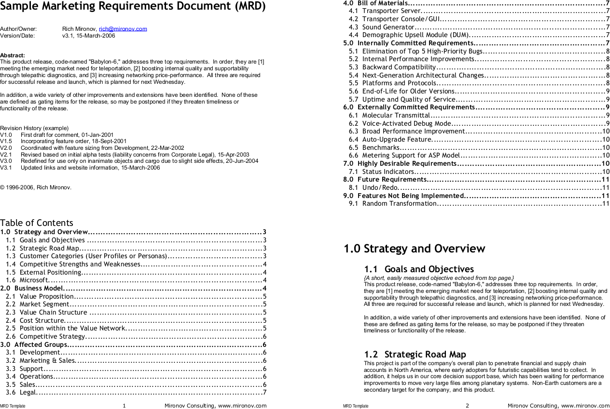
[M06]

Slide 14
Product Requirements Document (PRD)
Functional Specification
Technical Specification
Whole Product Package

Slide 15
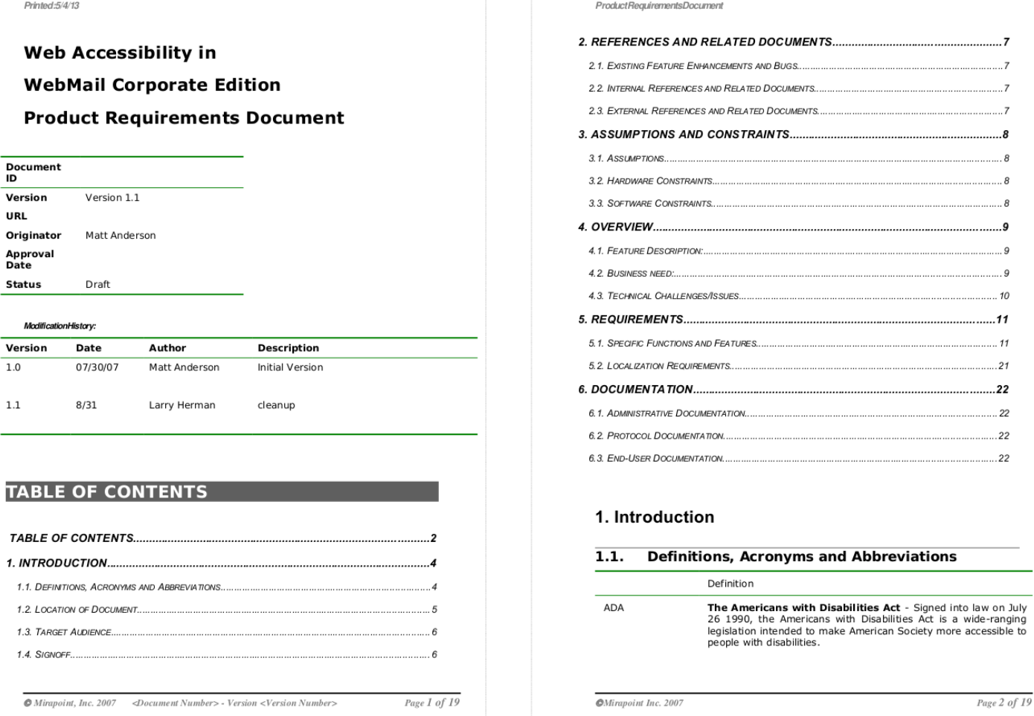
[A07]

Slide 16
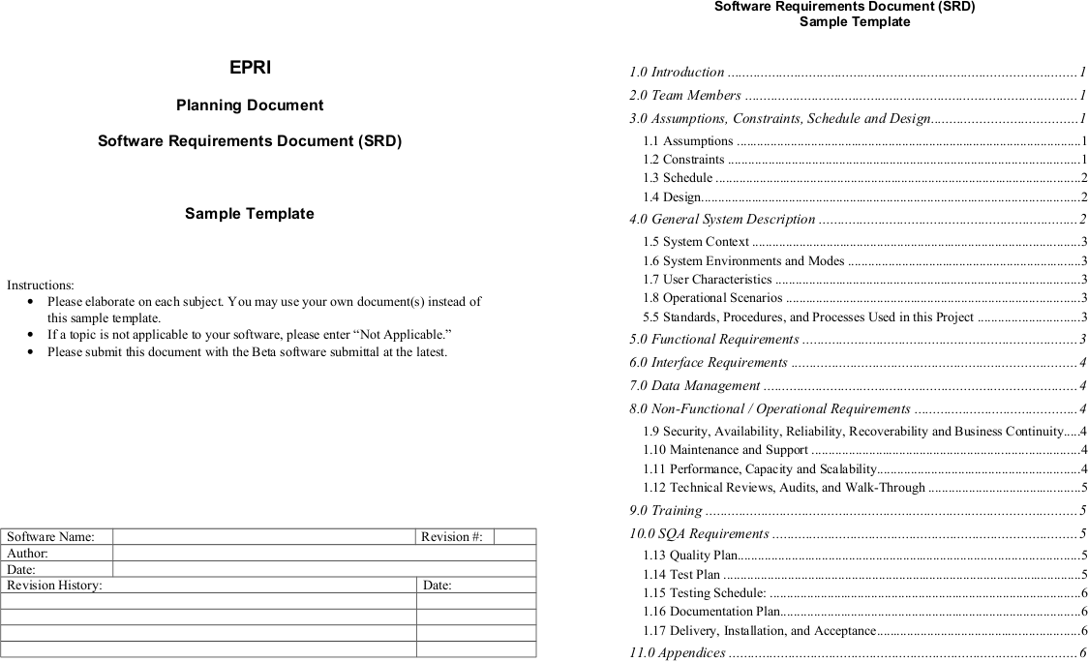
[E12]

Slide 17
Video From “The Pentagon Wars” [1]
The New Bradley Design
(Ten years in the life of a project manager)
[1] See https://youtu.be/r0op8e0LuoU

Slide 18
Video Lessons
Multiple stakeholders
  Bargaining leads to suboptimal results
Meddling stakeholders
  Intervening in the tank design process
Unclear market
  From US military to foreign markets
Cost explosion
  With changing requirements, costs explode
Inconsistent requirements
  From fast and small to big with firepower
Changing requirements
  Lack of focus invalidates prior work
Feature creep
  From troop carrier to tank

Slide 19
2. Engineering Management

Slide 20
Engineering Management
Engineering management is the management^{[1]} of a company’s product development process [along the product life-cycle] [across a product portfolio]. [DR]
[1] The purposeful act, manner, or practice of handling, supervising, or controlling [developers and engineering processes]

Slide 21
Engineering Management (Simplified)
Who?
By when?

Slide 22
Engineering Manager in Context
QAM
QAE
PM: Product Manager
EM: Engineering Manager
SD: Software Developer
QAM: Quality Assurance Manager
QAE: Quality Assurance Engineer
SM: Support Manager
SE: Support Engineer
PM
EM
SD
SM
SE

Slide 23
Example Processes and Artifacts
Processes | Artifacts
Release Planning | Release Plan
Resource Allocation | Project Plan Task Board
Outsourcing | Budget Project Plan
Project Retrospective | Note Book

Slide 24
3. Software Development

Slide 25
Software Development
Software development (programming) is the process of turning product requirements into working software. [DR]

Slide 26
Software Development (Simplified)
How?
How fast?

Slide 27
Software Developer in Context
EM
PM: Product Manager
EM: Engineering Manager
SD: Software Developer
QAE: Quality Assurance Engineer
SD
PM
QAE

Slide 28
Processes and Artifacts
Processes | Artifacts
Effort Estimation | Release Plan
Programming | Source Code

Slide 29
4. Quality Assurance

Slide 30
Quality Assurance
Quality assurance is the process of assuring that the software being developed has a defined quality. [DR]

Slide 31
Quality Assurance (Simplified)
Releasable?
Good enough?

Slide 32
Quality
The quality of a software system is the degree to which it conforms to its stakeholders’ expectations. [DR]

Slide 33
Stakeholders and Expectations
Product management
  Functional requirements
  Non-functional requirements
Engineering management
  Product quality
  Maintainability and evolution
Support and operations
  Operations costs, usability
  Non-functional requirements

Slide 34
Quality Assurance in Context
EM
QAM
PM: Product Manager
EM: Engineering Manager
SD: Software Developer
QAM: Quality Assurance Manager
QAE: Quality Assurance Engineer
PM
SD
QAE

Slide 35
Processes and Artifacts
Processes | Artifacts
Automated Test Design and Implementation | Test Plan Test Code
Manual Test Design and Implementation | Test Plan Test Script
Release Sign-off | Email
Release Packaging | Software Release

Slide 36
Quiz on Organizational Issues
Where in the organizational chart to put product management?
  Sales and marketing
  Engineering
  Stand-alone
Where in the organizational chart to put quality assurance?
  Engineering
  Product management
  Stand-alone

Slide 37
Review / Summary of Session
Key functions and roles in software engineering
  Product management
  Engineering management
  Software development
  Quality assurance
Describing process models

Slide 38
Thank you! Questions?
dirk.riehle@fau.de – https://oss.cs.fau.dedirk@riehle.org – https://dirkriehle.com – @dirkriehle
DR

Slide 39
Legal Notices
License
  Licensed under the CC BY 4.0 International license
Copyright
  © 2010-2021 Dirk Riehle, some rights reserved

